Slide 1
Trusts Law
Week 3: Formalities (I)
Dr Johanna Jacques

Slide 2
Settlors as trustees and beneficiaries
Yes
Settlor X transfers property to trustee Y, to hold on trust for Y and Z.
Settlor X transfers property to trustee Y, to hold on on trust for X.
Settlor X declares herself trustee of property, to hold on trust for Z.
Settlor X declares herself trustee of property, to hold on trust for X and Z.
No
Settlor X declares herself trustee of property, to hold on trust for X.

Slide 3

Terminology: Equitable and beneficial interests
In this course, we often use the terms ‘equitable interest’ and ‘beneficial interest’ interchangeably.
This is because when we are concerned with equitable interests, we are chiefly concerned with equitable beneficial interests under a trust (there are other equitable interests).
And when we are concerned with beneficial interests, we are chiefly concerned with equitable beneficial interests (strictly speaking, an absolute owner also holds a beneficial interest – the legal beneficial interest).
This is all very confusing. Here is what you need to know: Absolute owners do not hold an equitable beneficial interest for themselves, in addition to the legal interest. They simply hold no equitable beneficial interest at all. As soon as the equitable interest is split off and attaches to someone else, the absolute owner becomes a trustee.

Slide 4
Perhaps the most important feature of the trust
Company
Company
£30:
Owns £20 outright
Trustee of £10
Insolvent:
Only £10 left
£10 of goods
£10
£10
Proprietary right
Supplier (Credit)
Lender
(Unsecured loan)
Customer
(Trust)

Slide 5
This week
This week:
The formalities that are necessary to create express inter vivos and testamentary trusts
Some examples of the operation of equitable maxims
Secret trusts as an exception to the formality requirements

Slide 6
Learning objectives this week
To confidently know how to create a trust*
To understand that there is some flexibility around the requirements
*in the most general sense – most trusts need a trust instrument, which should not be drawn up without legal advice
To know the difference between secret and half-secret trusts

Slide 7
Requirements for an express trust
The types of trust:
Express trusts
Implied trusts
- Resulting trusts
- Constructive trusts
Requirements:
Capacity
Formalities for creation
Public policy
Formalities for the disposition of equitable interests
Certainties
Constitution
Perpetuity rules

Slide 8

Formalities for trusts created inter vivos (I)
Personal property:
  None; may be created by parol

Slide 9

Formalities for trusts created inter vivos (II)
Real property (land):
  Law of Property Act 1925: ‘manifested and proved by some writing signed [by the settlor]’ (s. 53(1)(b)).
  But note: This does not apply to constructive and resulting trusts.
  Rochefoucauld v Boustead [1897]

Slide 10

A word on equitable maxims
Equitable maxims are principles that equity has developed over time. They summarise the approach equity has taken to legal solutions and serve as organising principles.
They are ‘encrusted with judicial interpretation over the centuries’ (Penner).
Examples include:
  Equity will not permit a statute to be used as an instrument of fraud.
  Equity will not permit a trust to fail for want of a trustee.
  Those who come to equity must come with clean hands.
  Equity looks to substance rather than to form.

Slide 11
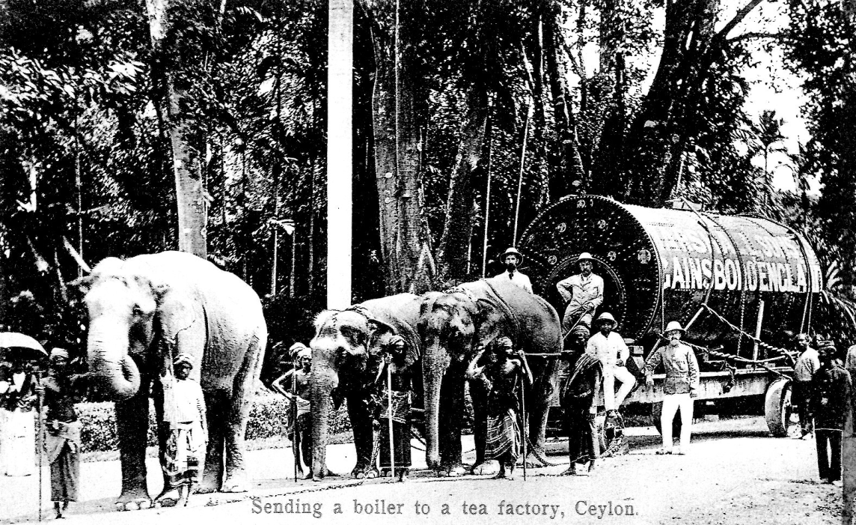
Rochefoucauld v Boustead [1897]
Coffee plantations
Coffee plantations
Dutch company
Boustead
3rd party
£££
Comtesse de la Rochefoucauld

Slide 12
Interesting thought
Does the equitable principle applied in Rochefoucauld also apply if land is acquired from a third party and then orally declared to be held on trust for a beneficiary? This was proposed in Re Smith [2023] EWHC 255 (Comm). However, Justice Foxton said the following, at [7-8]:
“[. . . ] that principle [that equity will not permit a statute to be used as an instrument of fraud] is only engaged when property is transferred by a beneficiary to the putative trustee on the basis of an oral agreement that the property will be held on trust when received, with the trustee then seeking to rely on the absence of written record of the trust to preclude the beneficiary from challenging the absolute nature of the transfer. This is not such a case; rather it is a case in which Dr Smith acquired the property from a third party and is said, either contemporaneously or immediately afterwards, to have made an oral declaration of trust. The distinction between those two types of cases is clear [. . . ]. In the second type of case, the absence of writing cannot so easily be overcome. If it could, if I may permit myself the Chancery luxury, it would be to drive a coach and four through the requirement for writing under the 1925 Act.”

Slide 13
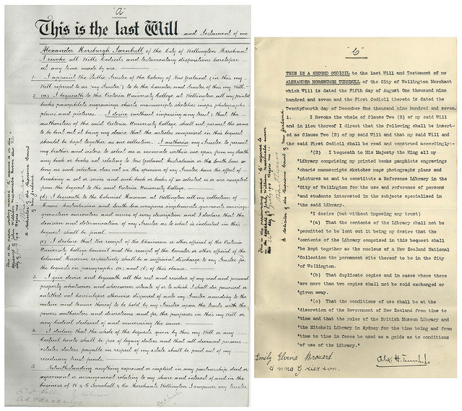
Formalities for testamentary trusts
All property:
Wills Act 1837: ‘in writing, and signed by the testator […] in the presence of two or more witnesses […] each witness […] attests and signs the will’ (s. 9)

Slide 14
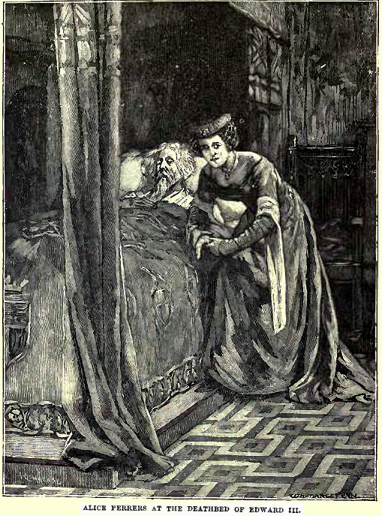
Exceptions
  Two exceptions to the formality requirements for testamentary trusts:
  Fully secret trusts
  Half-secret trusts

Slide 15
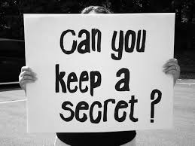
The fully secret trust
Requirements:
  Intention
  Communication
  Acceptance
Will
Death

Slide 16
Fully secret trusts are very hard to prove…
  … without evidence. See this case involving a Durham student (Re Mattingley [2021] EWHC 3353 (Ch)):
  https://www.dailymail.co.uk/news/article-10316169/Durham-student-loses-court-battle-aunt-late-mothers-600-000-Kent-home.html

Slide 17
The half-secret trust
Requirements:
  Intention
  Communication
  Acceptance
half-
Will
Death

Slide 18
Pay particular attention to…
…intention: For fully secret trusts, there must have been an intention to create a legal rather than moral obligation: Re Snowden [1979] Ch 528. This is not an issue for half-secret trusts.
…what happens on failure: For fully secret trusts, the legatee takes the property beneficially. For half-secret trusts, the property results back to the residuary estate.
…what happens if the intended trustee pre-deceases the testator/testatrix: For fully secret trusts, the secret trust fails, and the property goes into the residual estate. For half-secret trusts, the trust is upheld, as equity will not permit a trust to fail for want of a trustee.

Slide 19
Formalities for the creation of an express trust - overview
 | Inter vivos | Testamentary
Personal property | Parol | In writing + witnessed (WA)
Real property | Evidenced by writing (LPA) | In writing + witnessed (WA)
But remember, exceptions apply.

Slide 20
Activity
Have a look at Janis Joplin’s will and note the testamentary trust for her brother that she created (see ‘Article Seventh’):
https://www.truetrust.com/Famous_Wills_and_Trusts/Janis_Joplin_Will.pdf

